Slide 1
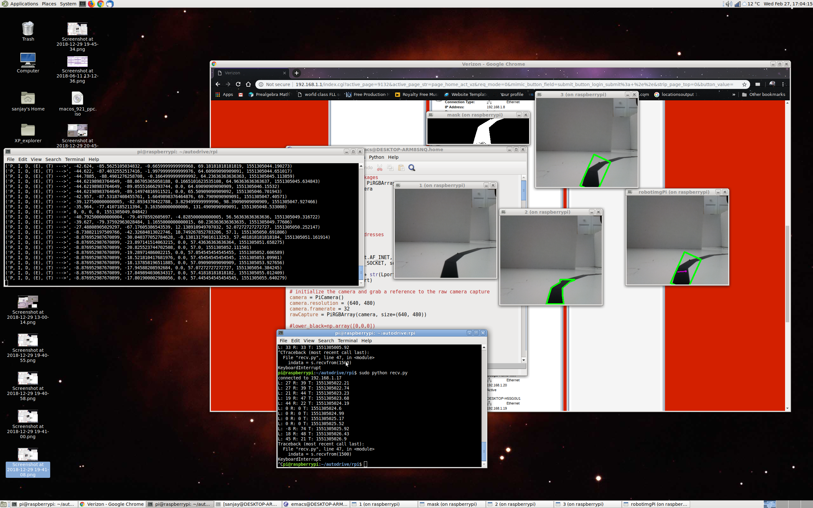
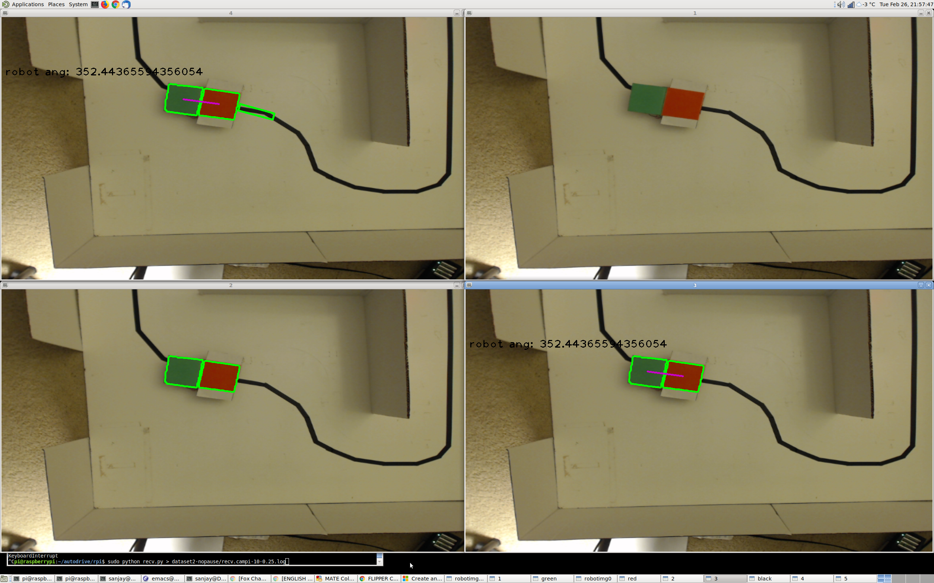
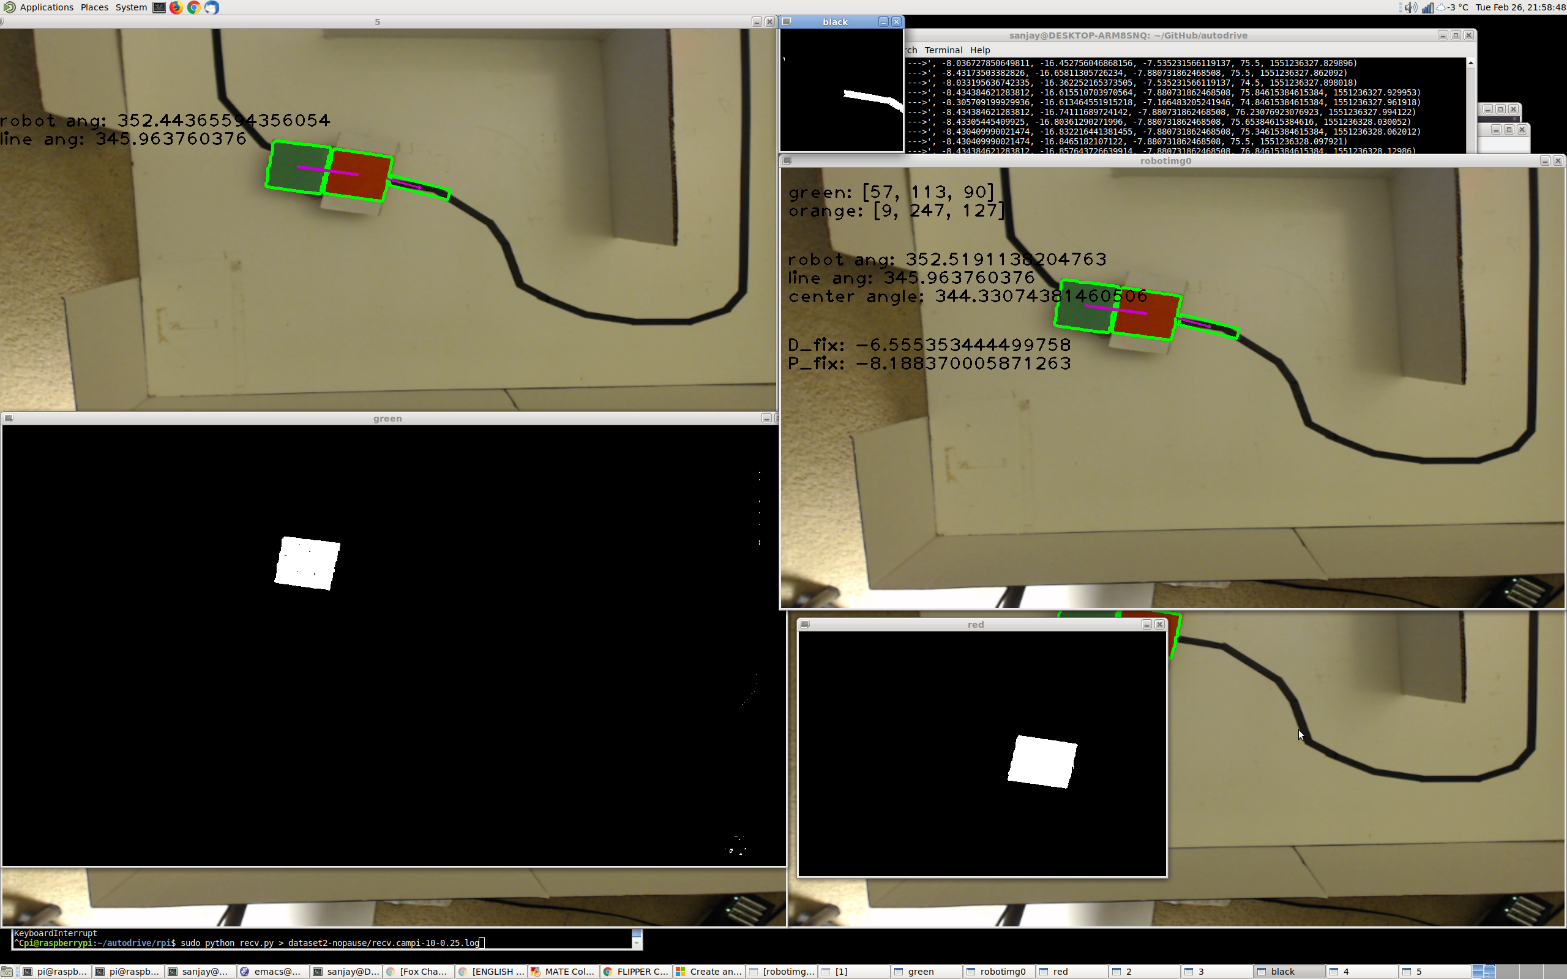





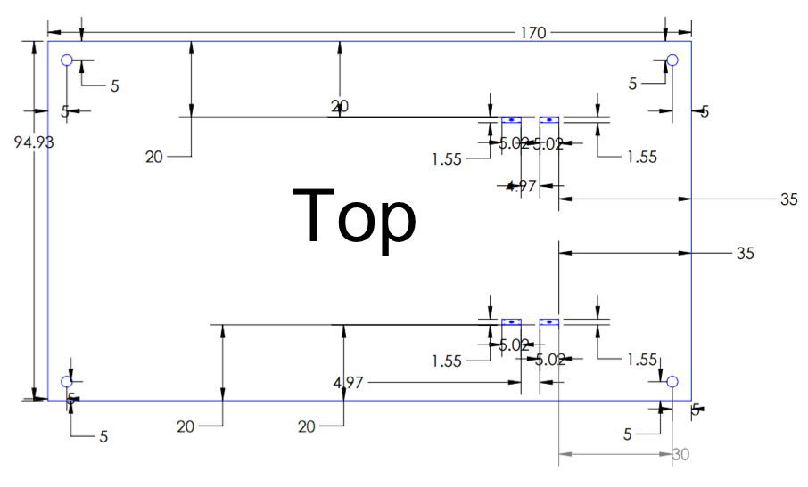
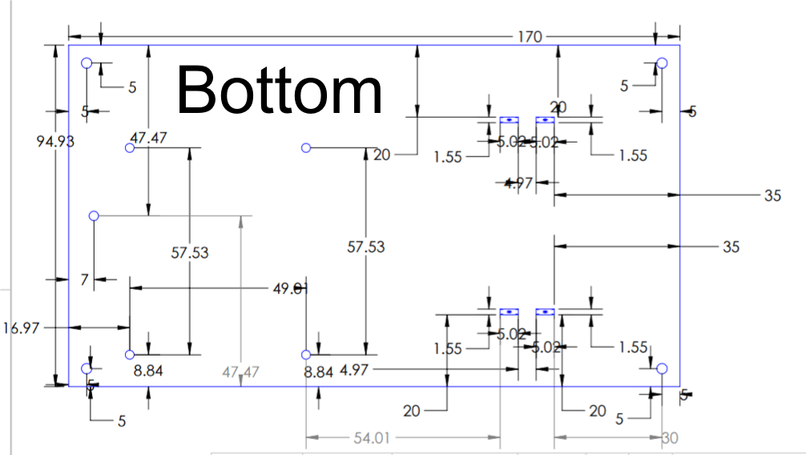
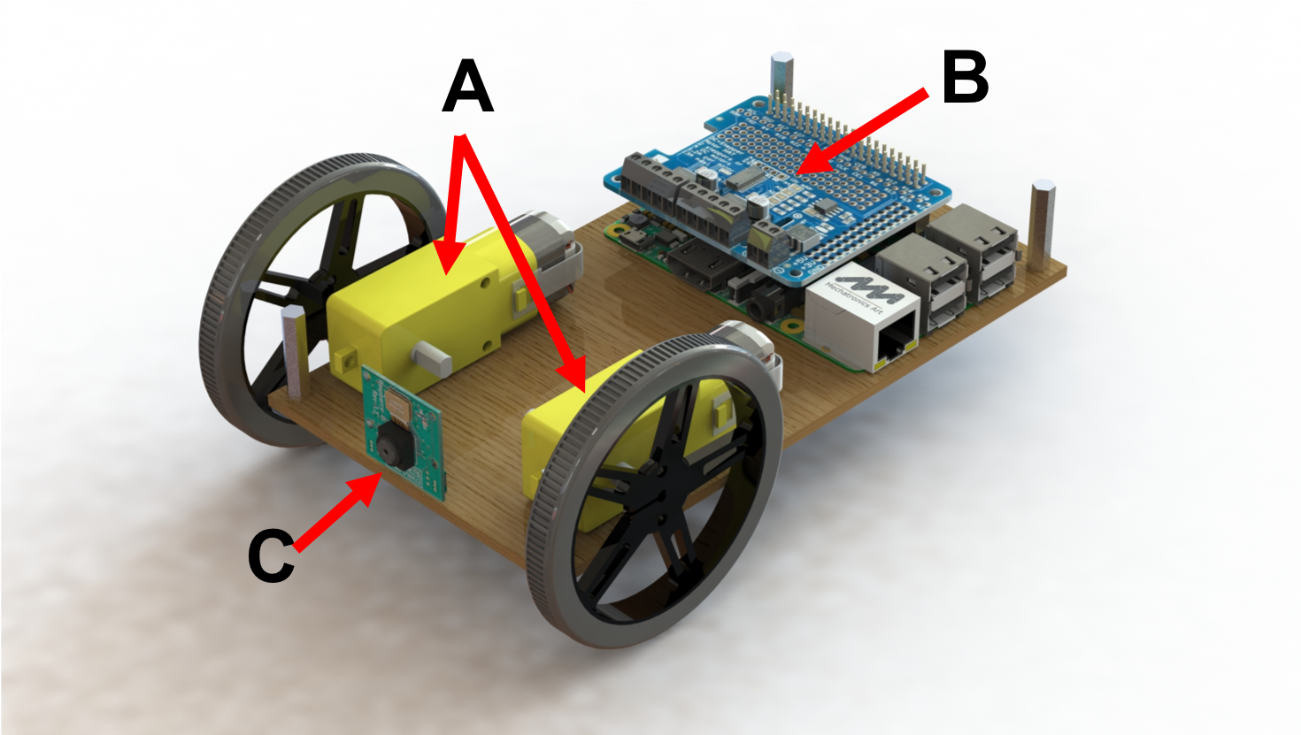


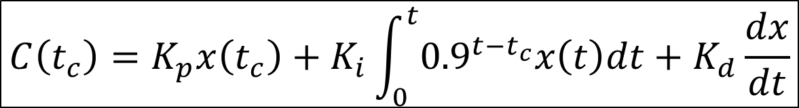
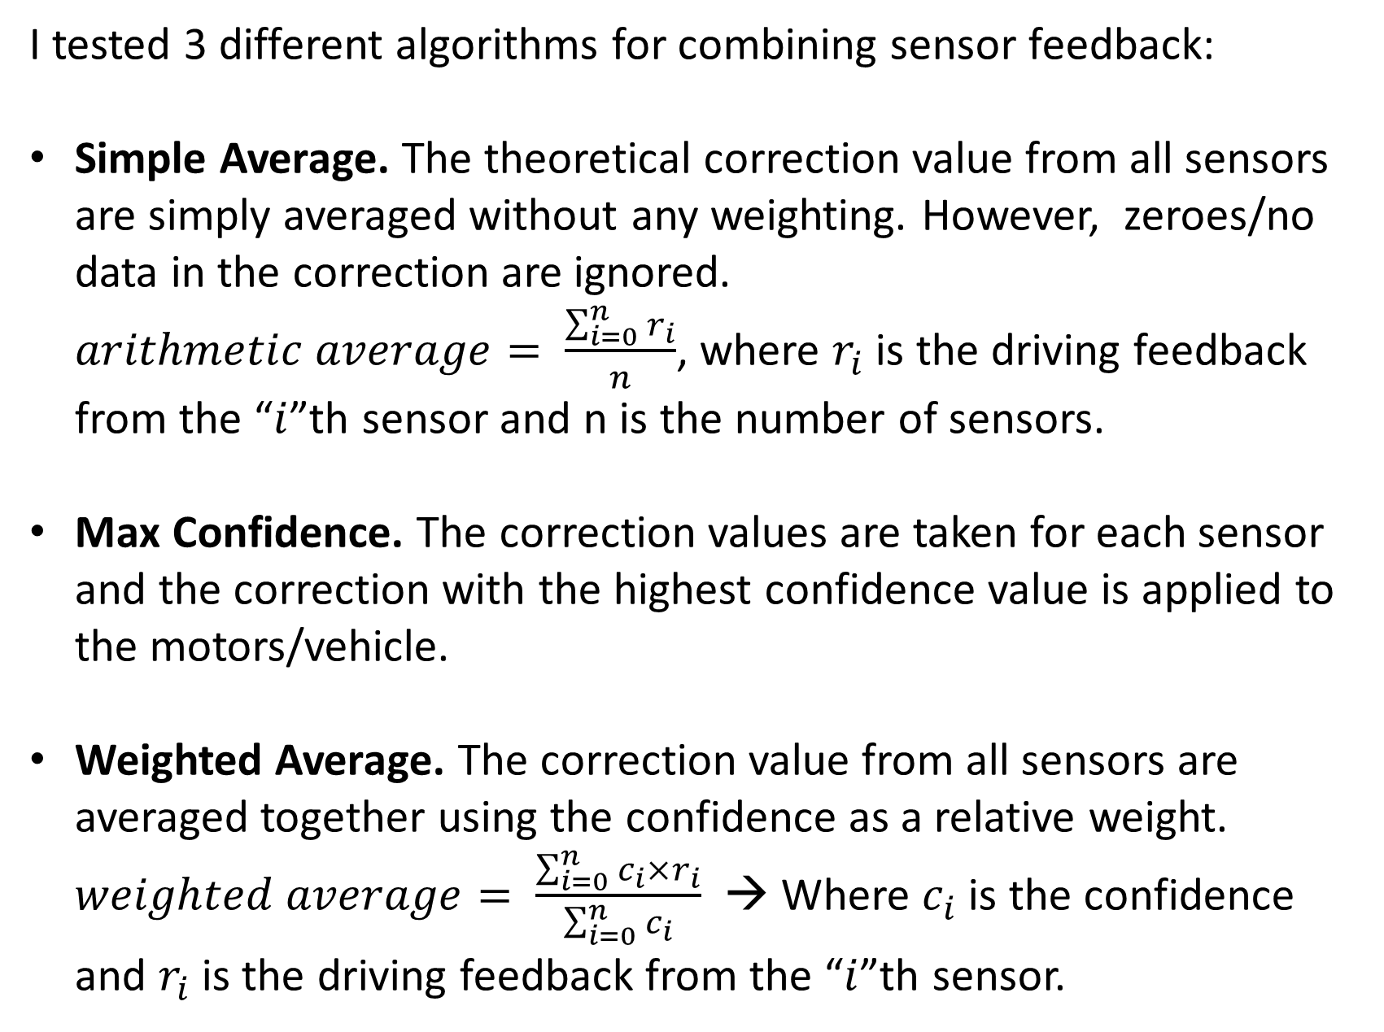
Horus: Using Sensor Fusion to Combine
Infrastructure and On-board Sensing to Improve Autonomous Vehicle Safety
By Sanjay Seshan
MOTIVATION
AUTONOMOUS DRIVING SOFTWARE
EXPERIMENTAL EVALUATION
Market research predicts that the demand for autonomous vehicles will increase tenfold between 2019 and 2026
Recent high-profile incidents (e.g. the fatal accidents with Uber and Tesla self-driving vehicles) have significantly impacted consumer confidence in this technology
Most accidents result from failures of sensors to accurately detect obstacles/pedestrians
A recent study by AAA reports that three-quarters of Americans are too afraid to ride in an autonomous vehicle and two-thirds feel less safe when self-driving cars are present.
Part 1: On-Vehicle Sensor Processing
Part 2: Infrastructure Sensor Processing
METRICS: When it is navigating efficiently, the below metrics should be close to zero. The greater the magnitude of these values, the further off the robot is from the optimal position and the worse the quality of the navigation.
Capture image (a)
(a)
Capture image (a)
Position Error
Direction Error
Steering Correction
Identify black pixels(b)
Identify green/orange pixels (b)
(a)
(b)
P_error
D_error
Identify largest black region (c)
(b)
orange
green
How far is the car from the road?
What is the angle between road and car?
How much steering is needed to get the car onto the road?
RESEARCH GOALS
Identify largest colored regions (c)
PID TUNING:
I use the Ziegler-Nichols method for tuning. With, K_{i}, and K_{d} set to 0, I adjust K_{p} and record driving quality (graph on right). K_{p} is set to 1.5 since it provides close to minimum error and stable performance. K_{i} is tuned similarly with K_{p}=1.5 and K_{d} is tuned last. Each sensor is tuned independently.
Draw rectangle around region (d)
(c)
Draw line between regions (d)
(c)
(d)
Can an autonomous vehicle that leverages data from infrastructure sensors navigate more reliably than those using just on-vehicle sensors?
How can the data from different sensors be fused?
Real-World Scenario
Compute distance to frame center (error estimate) (e)
Compute angle of drawn line
Position Error (scaled units)
CCTV on buildings, bridges and roads
Compute change and integral of error estimate
Autonomous vehicle has its own sensors, but receives data from surrounding cameras
(d)
Crop image in front of robot
(e)
(f)
Compute correction from angle & distance errors
Identify largest black region
Key Variables:
Vary number/placement of sensors that are present
Frequency of sensor failures
Sensor fusion algorithm
Transmit correction to robot
(e)
Draw rectangle around region (e)
Runs on the Raspberry Pi and analyzes the video from the on-vehicle camera using the OpenCV computer vision processing library.
Video processing code determines the location of the road in the frame
I use the Proportional-Integral-Derivative (PID) algorithm to compute the steering needed to center the vehicle on the road. A mathematical representation of the PID equation is seen below. A decay rate of 10% is used on the integral to avoid integral windup, where old integral values affect the steering too much.
Compute angle & center (f)
(g)
Position Error (scaled units)
Position Error (scaled units)
PROTOTYPE DESIGN
Compute angle differences between robot & rectangle
Custom design to fit Raspberry Pi, motor, batteries, camera
Designed in SolidWorks, laser cut using GlowForge home laser cutter
1:30 scale of a real car
Orange/Green Color-coded top panel for easy identification of vehicle by infrastructure sensors
Runs on a Debian Linux PC
Collects video from an infrastructure camera and analyzes it to identify the relative location of the vehicle to the road.
This code also computes a steering correction using a PID control system.
The correction estimate is sent to the Raspberry Pi using the UDP protocol for network transfer.
Compute distance between robot & rectangle centers
Impact of Outages
Compute correction from angle & distance errors
Measurement of driving quality (position error and correction) as outage duration increases.
To test the impact of sensors outages have navigation quality, I disabled the on-vehicle camera for a fixed duration (varied on x-axis) every 10 seconds.
Longer outages resulted in larger position errors and more correction to get the vehicle back on track. The vehicle could no longer follow the road for outages longer than 1 second.
$$C\left(t_{c}\right)=K_{p}x\left(t_{c}\right)+K_{i}\int_{0}^{t}{{0.9}^{t−t_{c}}x\left(t\right)dt}+K_{d}\frac{dx}{dt}$$
Transmit correction to robot (g)
TRIFOLD AREA – THIS GUIDE WILL BE REMOVED BEFORE PRINTING – TRIFOLD AREA – THIS GUIDE WILL BE REMOVED BEFORE PRINTING – TRIFOLD AREA – THIS GUIDE WILL BE REMOVED BEFORE PRINTING – TRIFOLD AREA – THIS GUIDE WILL BE REMOVED BEFORE PRINTING – TRIFOLD
TRIFOLD AREA – THIS GUIDE WILL BE REMOVED BEFORE PRINTING – TRIFOLD AREA – THIS GUIDE WILL BE REMOVED BEFORE PRINTING – TRIFOLD AREA – THIS GUIDE WILL BE REMOVED BEFORE PRINTING – TRIFOLD AREA – THIS GUIDE WILL BE REMOVED BEFORE PRINTING – TRIFOLD
Part 3a: Vehicle Control Code
Part 3b: Sensor Fusion Algorithms
Rendering of SolidWorks design of vehicle bottom mounting plate and hardware. Labels identify (A) DC motors, (B) Raspberry PI and DC motor controller HAT and (C) Raspberry Pi camera.
Runs on the Raspberry Pi and receives the steering instructions from different camera systems (both infrastructure and on-vehicle).
In order to combine input from different sensors, I need the sensor input to have two key properties:
Common Scale: The software associated with a sensor feed may produce local position and direction error values differently. However, they must report navigation feedback to the vehicle on a common universal scale. I choose to use motor steering correction values as this common scale.
Confidence Values. Each sensor report should provide both feedback and an associated confidence value to indicate accuracy. This enables the vehicle control software to weight the different inputs when combining them.
I tested 3 different algorithms for combining sensor feedback:
Simple Average. The theoretical correction value from all sensors are simply averaged without any weighting. However, zeroes/no data in the correction are ignored. $arithmetic average= \frac{\sum_{i=0}^{n}{r_{i}}}{n}$, where $r_{i}$ is the driving feedback from the “$i$”th sensor and n is the number of sensors.
Max Confidence. The correction values are taken for each sensor and the correction with the highest confidence value is applied to the motors/vehicle.
Weighted Average. The correction value from all sensors are averaged together using the confidence as a relative weight. $weighted average= \frac{\sum_{i=0}^{n}{c_{i}×r_{i}}}{\sum_{i=0}^{n}{c_{i}}}$ → Where $c_{i}$ is the confidence and $r_{i}$ is the driving feedback from the “$i$”th sensor.
Comparing Different Sensor Fusion Algorithms
Measurement of driving quality (correction) as outage probability increases
TESTBED DESIGN
A 2m × 2m white board with a black line to represent the road. The area is walled to create blocked views
A Linux PC with two HD-quality webcams to simulate the infrastructure sensors and computation resources
Autonomous vehicle prototype
HD webcams
CONCLUSIONS & NEXT STEPS
To test navigation with multiple in use, every 0.4 seconds, I disable each sensor with a fixed probability. This outage probability is varied from 5% to 45% (x-axis).
The lines on the graphs represent different sensor fusion algorithms or sensors used.
Weighted average provides the best driving quality (lowest on graph) and most resilience to outages.
Using sensor fusion, it is possible to combine on-vehicle sensor data with infrastructure sensor data to reliably navigate an autonomous vehicle.
Infrastructure and on-vehicle sensors can be used effectively in combination to create a system that is resilient to sensor reading failures, network delays/losses, and other issues.
My research showed using infrastructure-based sensors increased the reliability of navigation significantly – in a scenario with one on-vehicle camera and two infrastructure cameras with overlapping views, the system could successfully navigate despite sensors being unavailable 40% of the time.
Sensor fusion techniques are beneficial and can be used, but we need to be careful about what fusion techniques are used. Using a weighted average approach provided the best driving quality and coverage. Any application of multiple sensors will provide confidence values per sensor to optimize the correction.
Experimental Limitations and concerns
Realism: The real world involves multiple vehicles and multiple cameras that need to be coordinated
Coverage: External cameras will not always be able to detect or identify individual cars, depending on the density of traffic, etc.
Security & Privacy: Not a concern as not personally identifiable information such as license plates are collected or used. As the data is transmitted wirelessly, it must be cryptographically signed so that outsiders cannot interfere with the data
Next Steps: 1) controlling multiple vehicles concurrently and 2) more realistic testing using simulation software and actual car tests with wireless OBD-II interface.
Simulated road
2 meters
StdDev Correction (Motor Power Units)
Autonomous vehicle prototype
2 meters
Standard deviation graph offers an alternative view of driving quality and represents how variable the feedback is rather than how strong the feedback is.
All images by Student © Sanjay Seshan 2019
Notes:
Setup and materials – merge
Prototype design – perhaps identify key properties/changes? Need sufficient computation capabilities to do image processing, high resolution camera, simplified color code,
Part 3:
Sensor fusion design → Key requirements
1st 2 graphs == metrics – make these smaller and put them side by side

